Slide 1
MMU
And
Overcommit

Slide 2
MMU
What is an MMU?
Memory
Management
Unit
The Memory Management Unit (MMU) abstracts Physical Memory into Virtual Memory. This abstraction allows various portions of the OS to have their own virtual memory maps thus providing safeguards to processes and permission restricted spaces. (i.e. kernel)
Every processor manufacturer will have a different implementation for their MMU architecture. However, the basic functionality will be the same, and invisible to the user. In this introduction we will focus on the ARM architecture.

Slide 3
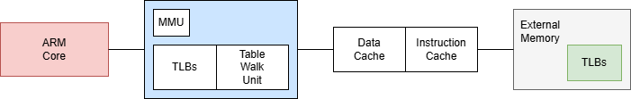
MMU
MMU High-Level Architecture
Memory Management Unit Block
The ARM core processes instructions
TLB: Translation Lookaside Buffer
Table Walk Unit performs the actual walk across the table caches to see if we have a hit or miss
There will be a TLB instance for both the Data Cache and the Instruction Cache
The External memory may hold multiple levels of TLBs

Slide 4
Translation Lookaside Buffer
MMU
Simply an Address Lookup
A TLB is essentially a simple mapping from Virtual Address (VA) to a Physical Address (PA)
A TLB will often be broken into two, or more, levels (i.e. L1 and L2)
TLBs were started during the 32-bit era and are limited in size to 4GB.
For 64-bit systems the HugeTLB, or Large Physical Address Extensions, help cover very large arrays of memory
The L1 TLB will be made up of 4096 16MB or 1MB memory page mappings with the most common being 1MB pages
The L1 TLB page entry may point to either physical memory, or to an L2 TLB
The L2 TLB, if there is one, contains 256 (1KB worth) of either 4KB or 64KB physical memory pages
A TLB represents the virtual address assignment for a given context and thus will be different for each process
A TLB page hit and miss represent when the memory requested does not have a physical mapping in the cache

Slide 5
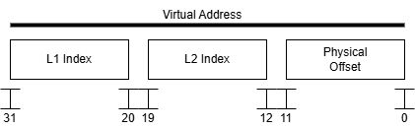
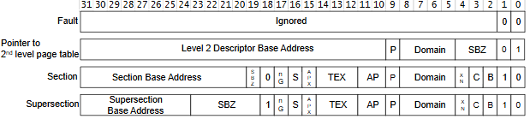
L1 TLB 1MB Pages
MMU
The first 12bits of a virtual address correspond to the index of the 1MB entry
The table entry contains a “first level descriptor” which may be one of four values
A “fault” entry that generates an Abort Exception (SIGABRT)
An entry that points to an L2 TLB
A 1MB section mapping to physical address
A 16MB supersection

Slide 6
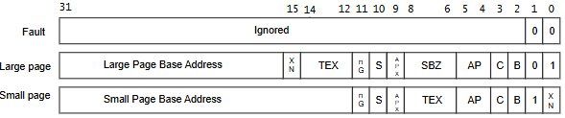
L2 TLB 4KB Pages
MMU
The middle 8bits of a virtual address correspond to the index of the 4KB entry
The table entry contains a “second level descriptor” which may be one of three values
A “fault” entry that generates an Abort Exception (SIGABRT)
A large page (16KB) descriptor
A small page (4KB) descriptor

Slide 7
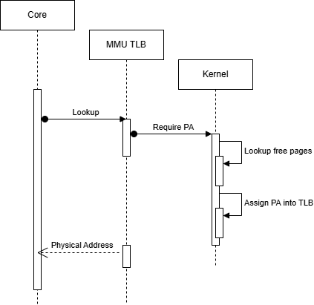
MMU Hit/Miss
MMU
If the physical address has been accessed before then it will be cached within the TLB. If this is the situation there will be no cost to processor.
If the is no physical address associated with the virtual address within the TLB then a miss occurs. In this instance all TLBs are walked and a system interrupt to the OS will occur
For Linux if a physical address needs to be assigned a complex series of actions need to take place.
Permission restrictions are verified on what memory may be accessed
Is the memory a “contiguous” assignment required (i.e. DMA)
Is the memory a large allocation small allocation
Swapping out least recently used memory to free up physical memory
Many, many, more possibilities
Once the physical memory has been assigned control is returned to the MMU and the physical address is provided to the core
Simplistically, every process (including kernel) has its own virtual address space. Thus, when a process context switch occurs the TLB must be cleared and any new virtual addresses accessed will be a miss. This can get expensive!

Slide 8
Overcommit
What is Overcommit?
Overcommit
Physical memory is limited, and Virtual memory is not. I know, shocking! A general-purpose OS cannot make demands on every process to know exactly how much memory is available at any given time, nor is it reasonable to guess how much memory the kernel should provide for basic operation of the process. With the advent of “swap” spaces the kernel can now move unused memory to slow, long term, storage. This in turn allows freeing up memory on the fly so that allocated memory may be provided for

Slide 9
Overcommit
Overcommit
Every Process has its own address space
The make-up of a process memory usage
Instructions
Constant Data
BSS
Stack
Dynamically allocated memory
Shared memory
As noted, when a process changes the TLB is cleared. This allows large virtual address spaces with very limited physical address
The kernel determines what physical address to assign, as well as, what processes it can move to swap space
Overcommit is non-deterministic
The amount of actual memory used in the system can not be determined at any given time

Slide 10
Resources
Resources
ARM: https://developer.arm.com/documentation/den0013/d/The-Memory-Management-Unit
Linux: https://docs.kernel.org/admin-guide/mm/index.html
Linux Overcommit: https://www.kernel.org/doc/Documentation/vm/overcommit-accounting

